Slide 1
Aspect Oriented Programming with Spring
Course “Spring – first touch”
Section 7

Slide 2
Agenda
AOP concepts
Custom aspects implementation
Declarative Transaction Management

Slide 3

AOP main idea
Add additional functionality to code without changing it!

Slide 4
AOP usage examples
Logging
Execution time measurement
Transaction management
Notification sending
etc.

Slide 5
AOP CONCEPTS

Slide 6
AOP concepts
Aspect
Join point
Pointcut
Advice
Target object
AOP proxy

Slide 7
AOP concepts - Aspect
A modularization of a concern that cuts across multiple classes.
import org.aspectj.lang.annotation.Aspect;
@Aspect
public class NotVeryUsefulAspect {
}

Slide 8
AOP concepts - Join point
In Spring AOP, a join point always represents a method execution.
Invoke method
Object 1
Object 2
Execute
method
Join point
Return response

Slide 9
AOP concepts - Pointcut
A predicate that matches join points.
@Pointcut("execution(* lv.Database.*(..))")
@Pointcut("execution(* lv.*.*(..))")

Slide 10
Pointcut expressions
execution(public * *(..))
execution(* com.xyz.service.AccountService.*(..))
execution(* com.xyz.service.*.*(..))

Slide 11
AOP concepts - Advice
Action taken by an aspect at a particular join point.
Examples:
  Open transaction
  Write log message
  Send mail to friend ☺

Slide 12
Advice + pointcut
Advice is associated with a pointcut expression and runs at any join point matched by the pointcut.
@Aspect
public class ProfilingAspect {
@Around("execution(public * lv.*.*(..))")
public Object profile(ProceedingJoinPoint pjp)
throws Throwable {
return pjp.proceed();
}
}

Slide 13
AOP concepts - Target object
Object being advised by one or more aspects.
Referred to as the advised object.
Spring AOP is implemented using runtime proxies, this object will always be a proxied object.

Slide 14
AOP concepts - AOP proxy
Object created by the AOP framework in order to implement the aspect contracts (advise method executions and so on).
In the Spring, an AOP proxy will be a JDK dynamic proxy or a CGLIB proxy.

Slide 15
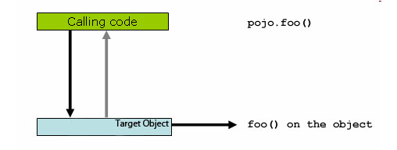
Direct method invocation

Slide 16
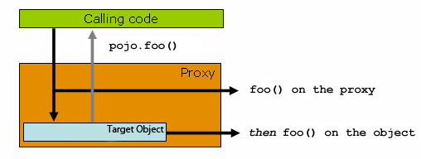
Indirect method invocation

Slide 17
CUSTOM ASPECTS IMPLEMENTATION

Slide 18
Aspect implementation steps
Choose advice type
Write aspect code
Integrate aspect to Spring IoC

Slide 19
Types of advice
Before advice
After returning advice
After throwing advice
After (finally) advice
Around advice

Slide 20
@Before advice
@Aspect
public class BeforeExample {
@Before("execution(* com.xyz.dao.*.*(..))")
public void doAccessCheck() {
// ...
}
}

Slide 21
@AfterThrowing advice
@Aspect
public class AfterThrowingExample {
@AfterThrowing(pointcut="com.MyDao.getUser()", throwing="ex")
public void doRecoveryActions(Exception ex) {
// ...
}
}

Slide 22
@After advice
@Aspect
public class AfterFinallyExample {
@After("com.MyDao.getUser()")
public void doReleaseLock() {
// ...
}
}

Slide 23
@Around advice
@Aspect
public class AroundExample {
@Around("com.MyDao.getUser()")
public Object doProfiling(ProceedingJoinPoint pjp) throws Throwable {
// start stopwatch
Object retVal = pjp.proceed();
// stop stopwatch return retVal;
}
}

Slide 24
Write aspect code
@Aspect
public class AroundExample {
@Around("com.MyDao.getUser()")
public Object doProfiling(ProceedingJoinPoint pjp) throws Throwable {
sendAlarmMail();
logSystemState();
return pjp.proceed();
}
}

Slide 25
Integrate aspect to Spring IoC
The @AspectJ support is enabled by including the following element inside your spring configuration:
<aop:aspectj-autoproxy/>

Slide 26
Spring AOP's approach
Close integration between AOP implementation and Spring IoC
@Aspect
@Component
public class DatabaseLogger {
//implementation goes here
}

Slide 27
DECLARATIVE TRANSACTION MANAGEMENT (DTM)

Slide 28
Declarative transaction management (DTM)
Enable transaction management inside IoC container.
This option has the least impact on application code.
Most Spring Framework users choose it.

Slide 29
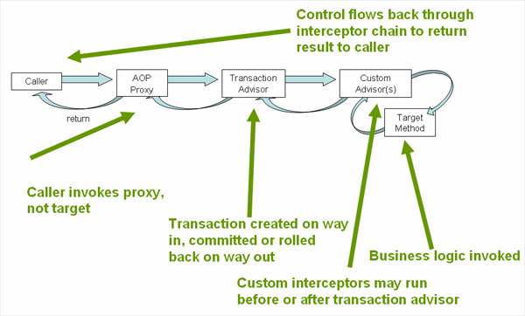
Understanding Spring DTM implementation

Slide 30
Enable DTM (1)
Annotate your classes
@Transactional
public class RealDatabase {
}

Slide 31
Enable DTM (2)
Enable @Transactional annotation preprocessing
Add the line to your configuration:
<tx:annotation-driven/>

Slide 32
Enable DTM (3)
Define transaction manager
<bean id="transactionManager"
class="org.springframework.jdbc.
datasource.DataSourceTransactionManager">
<property name="dataSource" ref="dataSource"/>
</bean>

Slide 33

Any Questions?

Slide 34

References
Spring in Action 2 edition
Spring documentation: http://www.springsource.org/documentation

Slide 35

Practice 7 and 8

